Slide 1
EDUBUK
Individualizing Learning with Trust
Website: www.edubuk.in
Email Id: support@edubuk.in
Contact No: +91-9591033169

Slide 2
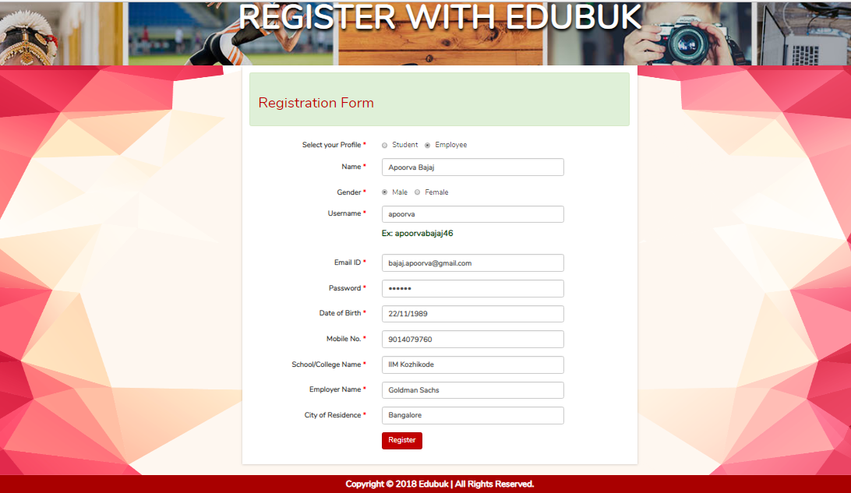

Slide 3
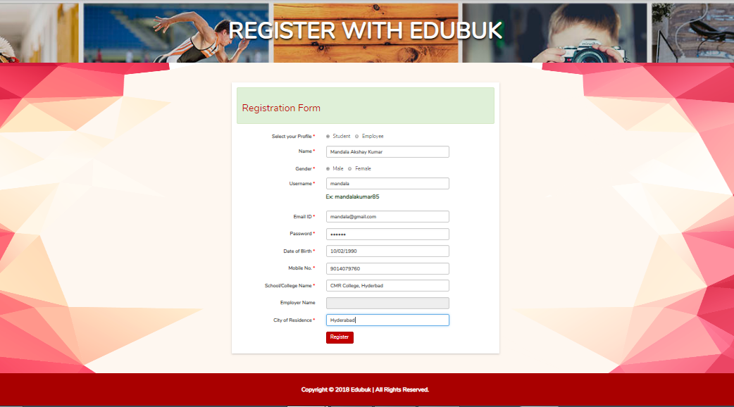

Slide 4
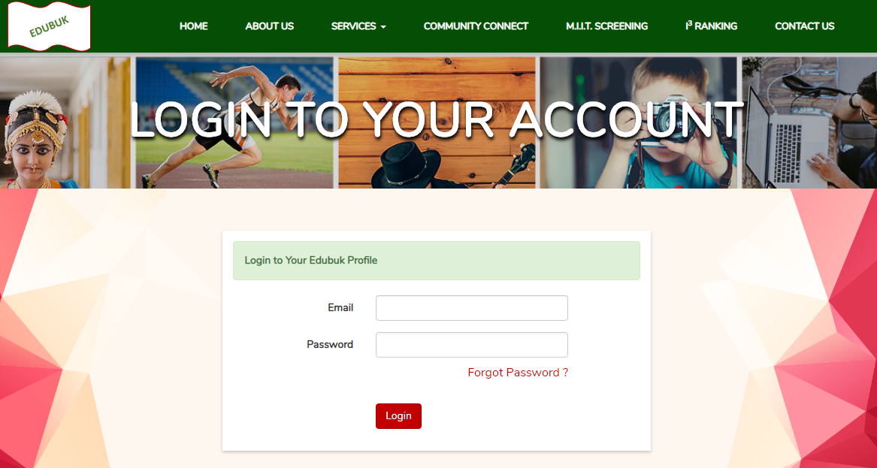

Slide 5
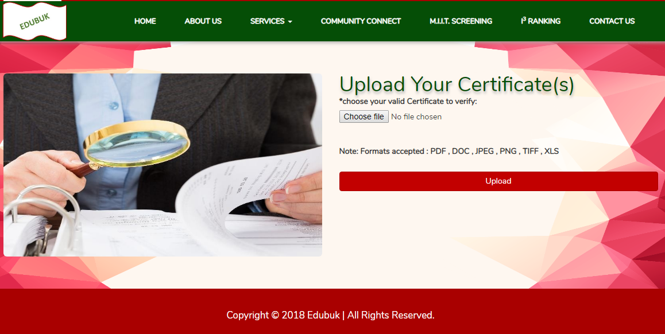

Slide 6
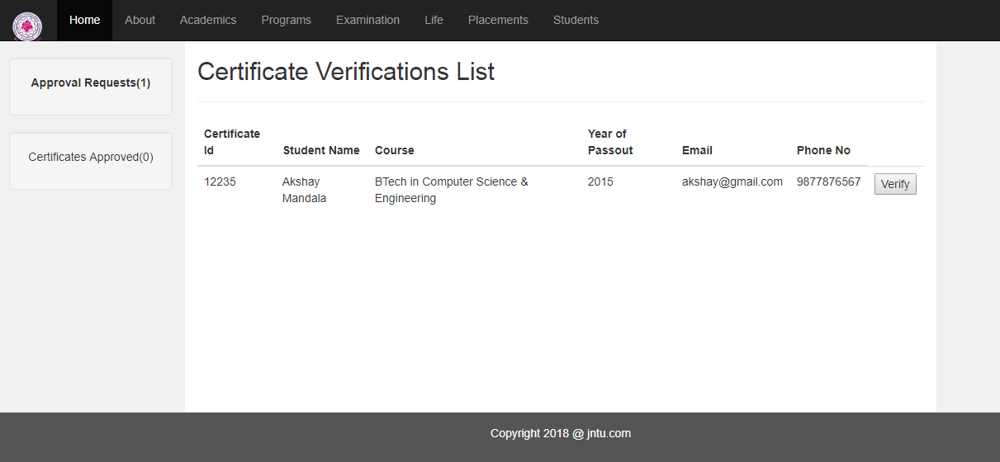

Slide 7
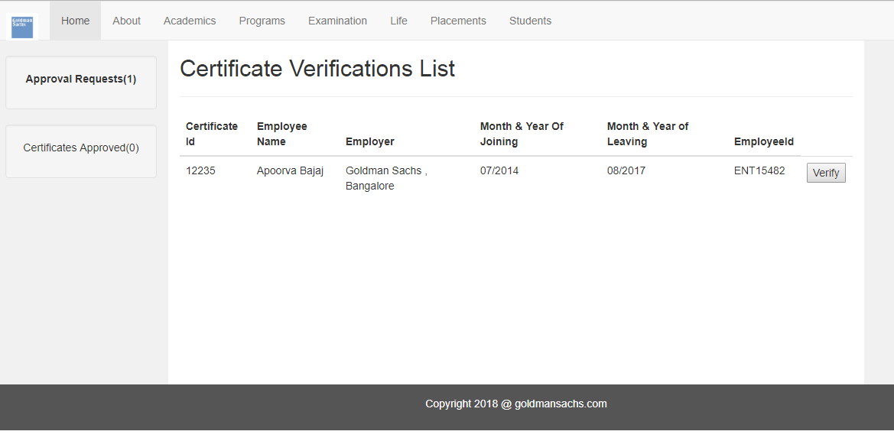

Slide 8
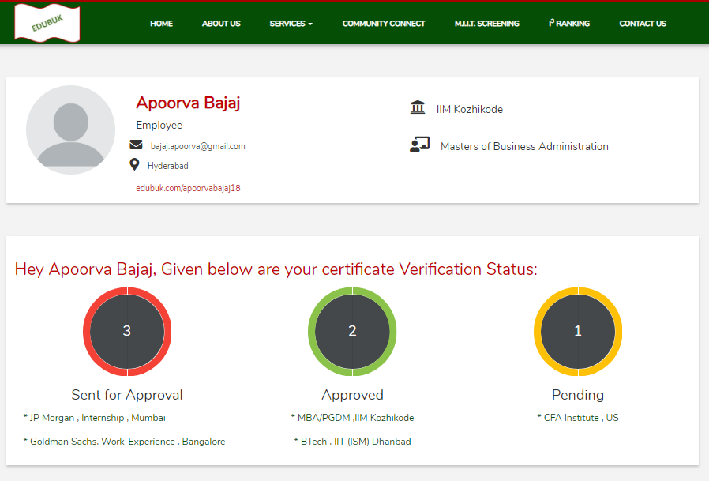

Slide 9

Thank You

